Slide 1
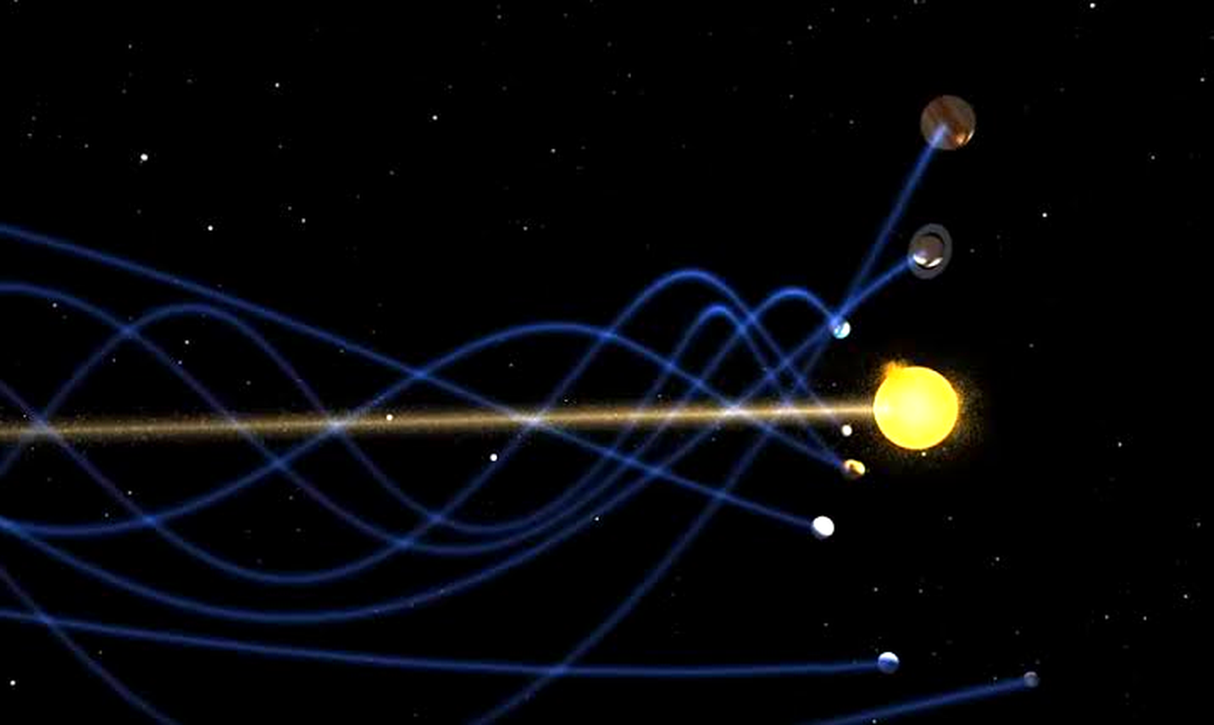
OBJECT-ORIENTED PROGRAMMING • COURSE PROJECT
Gravity Simulation
A Modular N-Body Physics Engine — Four Scenarios, Three Integrators, One Class Hierarchy
OOP • Dr. Susara S. Thenuwara

Slide 2




THE TEAM
Team Members
Dhinuka Sanju
Nilara Fernando
Nilmika Shaneth
Shemaya Perera
Team Member
Team Member
Team Member
Team Member
01

Slide 3

INTRODUCTION
What We'll Walk Through
AGENDA
This build reorganizes the simulator around a small, composed rendering package, adds a third integrator (RK4) alongside Euler and Verlet, and ships four complete scenarios — an accurate solar system, a random cluster for Barnes-Hut, the classic three-body figure-eight, and a real Jupiter gravity-assist. This deck walks through the idea, the architecture, and the physics behind all of it.
01
The Project
02
Gravity Simulation & Why
03
Four OOP Pillars
04
Program Structure
05
OOP In Our Code (x6)
Why it matters
Splitting rendering into composed pieces (effects, interaction, overlay) is itself a live OOP lesson — composition and single-responsibility, not just inheritance diagrams.
06
Program Explanation & Demo
07
Live Demonstration
08
Conclusion
02

Slide 4
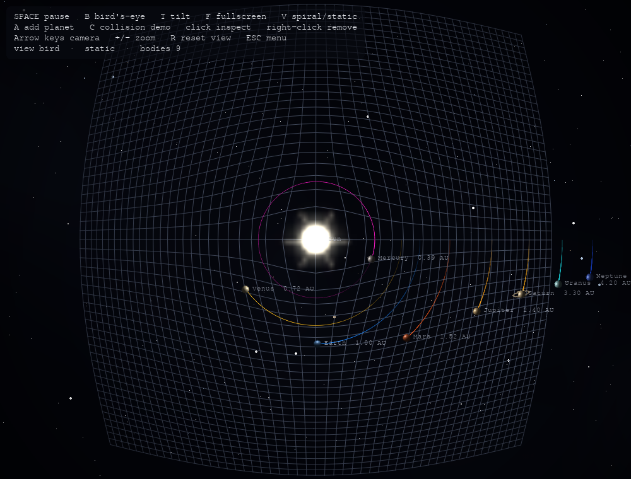
THE PROJECT
What Is Our Project About?
A real-time, 3D N-body gravity simulator in Python. Bodies pull on each other under Newtonian gravity; the scene renders as lit, shaded spheres with a day/night terminator, over a dented “spacetime fabric” grid — all configured from an in-app menu.
Four complete scenarios
Solar system, random cluster, three-body figure-eight, and a real Jupiter gravity assist.
Three swappable integrators
Euler, Verlet, and RK4 — compare their energy drift directly with --compare-integrators.
Barnes-Hut octree
O(n log n) approximate force calculation kicks in past ~450 bodies for large clusters.
Bird’s-eye view — all eight planets, live physics
Click any body to inspect its mass, speed, distance, and orbital period in real time.
A composed rendering package
Visualizer, BodyEffects, InteractionController, and UIOverlay each own one job.
03

Slide 5
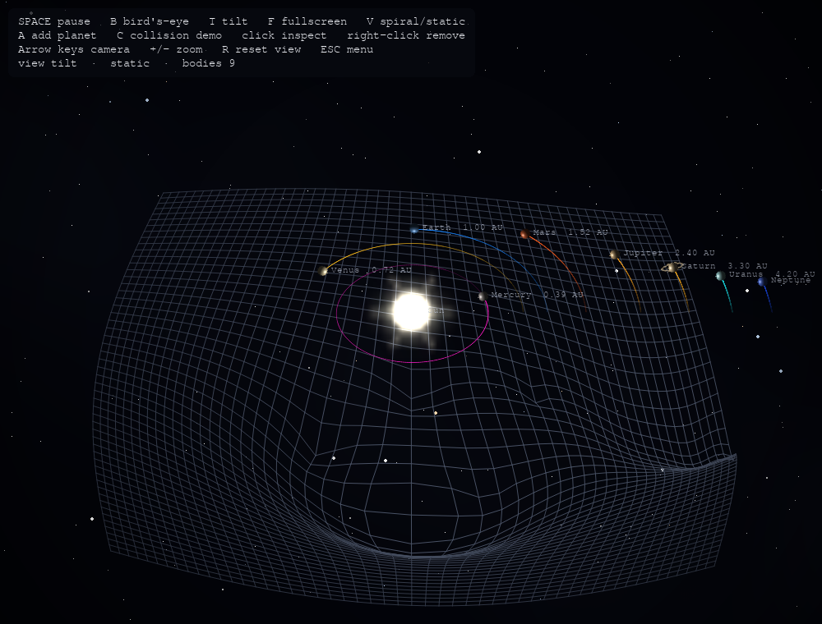
THE PHYSICS
What Is Gravity Simulation — and Why Use One?
A gravity simulation numerically models how masses pull on each other and move over time, step by step, instead of solving the motion with one closed equation.
NEWTON’S LAW OF GRAVITATION
F = G m₁m₂ / r²
Applied pairwise, every step, to every pair of bodies in the scene.
No closed-form solution exists for 3+ mutually attracting bodies — the figure-eight scenario only exists because someone simulated it first.
Makes invisible physics visible: a Jupiter slingshot, or energy drift between integrators, watched instead of just calculated.
The “spacetime fabric” grid bends under each body’s mass — a visual metaphor for a gravity well.
A safe sandbox to compare numerical methods — Euler vs. Verlet vs. RK4 — and see the trade-offs with your own eyes.
04

Slide 6




CORE CONCEPTS
What Is Object-Oriented Programming?
Object-oriented programming (OOP) is a way of structuring code around “objects” — self-contained bundles of data (attributes) and the behavior that acts on that data (methods) — instead of a long list of instructions operating on loose variables.
FOUR IDEAS MAKE IT WORK
Encapsulation
Protect an object's internal data
THE CORE IDEA
Abstraction
Model each real (or simulated) entity as a class: a Planet, an Integrator, a Camera. The object owns its own data and knows how to act on it — the rest of the program just asks it to do something, without needing to know how.
Hide complexity behind a simple interface
Inheritance
Reuse and extend existing classes
Why it fits a gravity simulator: planets, stars, cameras, and integrators are all naturally separate “things” with their own data and rules — exactly what classes model best.
Polymorphism
One call, many object-specific behaviors
05

Slide 7
CORE CONCEPTS
The Four Main OOP Pillars
Every design decision in this project traces back to one of these four ideas.
01
02
03
04
Encapsulation
Abstraction
Inheritance
Polymorphism
Bundling data with the methods that act on it, and hiding internal state behind controlled access.
Exposing only what a class needs to show, while hiding complex implementation behind a simple interface.
Letting a new class reuse and extend the fields and behavior of an existing one.
Calling the same method name on different objects, each responding with its own behavior.
06

Slide 8


THE CODEBASE
Program Structure — Main Files at a Glance
Sixteen files. Each one has exactly one job.
main.py
camera.py
Entry point — CLI parsing, menu wiring, the four scenario builders.
World-to-screen projection and free-camera controls.
menu.py
octree.py
Pre-launch settings screen; returns a plain settings dict.
Barnes-Hut approximation for large-N force calculation.
simulation.py
spacetime_grid.py
Owns the N-body physics: gravity, collisions, time-stepping.
The dipping “gravity well” grid visualization.
integrator.py
starfield.py / sphere_render.py
Euler / Verlet / RK4 time-stepping strategies.
Twinkling background stars, and lit-sphere body rendering.
body.py
rendering/ package
CelestialBody, Planet, and Star class hierarchy.
Visualizer (game loop) composes BodyEffects, InteractionController, and UIOverlay.
07

Slide 9
OOP IN OUR CODE — 1 OF 6
Encapsulation
body.py
# body.py
class CelestialBody(ABC):
def __init__(self, name, mass, ...):
self._mass = mass # protected
@property
def mass(self):
return self._mass
@mass.setter
def mass(self, value):
if value <= 0:
raise ValueError(...) # guarded
self._mass = value
What it is
Bundling data together with the methods that operate on it, then hiding the raw state behind controlled access instead of leaving it publicly writable.
In our project
CelestialBody._mass is a protected attribute, only reachable through the mass property. The setter rejects non-positive values, so an invalid physics state can never sneak in from outside the class.
08

Slide 10
OOP IN OUR CODE — 2 OF 6
Abstraction
body.py + integrator.py
# body.py
class CelestialBody(ABC):
@abstractmethod
def marker_size(self): ... # no body
# integrator.py
class Integrator(ABC):
@abstractmethod
def step(self, bodies,
compute_forces, dt): ... # no body
CelestialBody() # TypeError: abstract class
Integrator() # TypeError: abstract class
What it is
Defining what a class must do, without saying how — exposing a simple, guaranteed interface while hiding the messy implementation details behind it.
In our project
CelestialBody and Integrator are both ABCs — Python physically refuses to instantiate either one directly. Every concrete subclass is forced to fill in the missing method.
09

Slide 11
OOP IN OUR CODE — 3 OF 6
Inheritance
body.py + integrator.py
# body.py
class Planet(CelestialBody): # inherits
def marker_size(self): return 40
class Star(CelestialBody): # inherits
def marker_size(self): return 200
# integrator.py
class EulerIntegrator(Integrator): # inherits
class VerletIntegrator(Integrator): # inherits
class RK4Integrator(Integrator): # inherits
What it is
Letting a new class reuse the fields and behavior of an existing one, then extend or override only the parts that need to differ.
In our project
Planet and Star both extend CelestialBody. All three integrators — Euler, Verlet, and RK4 — extend Integrator. Shared plumbing lives once in the parent; only the physics differs per child.
10

Slide 12
OOP IN OUR CODE — 4 OF 6
Polymorphism
simulation.py + vector.py
# simulation.py
def step(self, dt):
self.integrator.step(
self.bodies, self._compute_forces, dt)
# works for Euler, Verlet, or RK4
self._handle_collisions()
# vector.py — operator overloading
def __add__(self, other): # Vector3D + Vector3D
return Vector3D(self.x + other.x, ...)
def __mul__(self, scalar): # Vector3D * scalar
return Vector3D(self.x * scalar, ...)
What it is
Calling the same method (or operator) on different objects and letting each one respond in its own way — the caller never needs a type check.
In our project
Simulation.step() calls integrator.step() without knowing which of the three concrete integrators is plugged in. Vector3D overloads +, -, and * so physics code reads like plain algebra.
11

Slide 13
OOP IN OUR CODE — 5 OF 6
Composition
simulation.py + visualizer.py
# simulation.py
class Simulation:
def __init__(self, integrator=None):
self.bodies = [] # has-a
self.integrator = (
integrator or VerletIntegrator())
# rendering/visualizer.py
class Visualizer:
def __init__(self, simulation, ...):
self.effects = BodyEffects(self) # has-a
self.interaction = InteractionController(self)
self.ui = UIOverlay(self) # has-a
What it is
Building a class out of other objects it owns (“has-a”), instead of trying to be everything itself through deep inheritance chains.
In our project
Simulation has-a body list and has-an Integrator. Visualizer has-a BodyEffects, InteractionController, and UIOverlay — the render-package split is composition, applied on purpose.
12

Slide 14
OOP IN OUR CODE — 6 OF 6
Design Patterns — Strategy & Factory
simulation.py + body.py
# simulation.py — Strategy pattern
self.integrator = integrator or VerletIntegrator()
self.integrator.step(self.bodies, ...) # swap freely
# body.py — Factory pattern
@classmethod
def from_dict(cls, data):
body_cls = BODY_CLASSES[data["type"]]
return body_cls(name=data["name"], ...) # builds
# the right subclass
Strategy
Integrator and its three implementations are a textbook Strategy pattern: swapping the time-stepping algorithm never touches Simulation or CelestialBody at all.
Factory
CelestialBody.from_dict() reads a "type" string from a saved JSON scene and looks it up in the BODY_CLASSES registry to construct the correct subclass — a small, clean Factory.
13

Slide 15
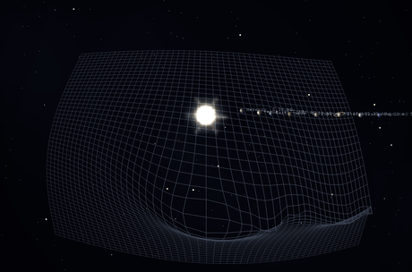
THE PROGRAM
Inside the Render Loop
Composed, not monolithic: Visualizer owns the loop; three collaborator classes do the rest.
1
Handle input — InteractionController reads keys & mouse, updates camera, pause state, or selection.
2
Step physics — Simulation.step() runs the active Integrator, then resolves any collisions.
3
Draw the scene — BodyEffects paints trails, lit bodies, and bursts over the grid and starfield.
4
Overlay & flip — UIOverlay draws the HUD / inspector, bloom is blended in, frame flips — 60x a second.
Live capture from our own simulation — real physics, real render.
14

Slide 16






UNDER THE HOOD
Key Technologies & Techniques
The ideas and tools that make the simulation both correct and fast.
Python 3.10+
Pygame
NumPy
Core language — ABCs, properties, and dataclass-style structure throughout.
Real-time render loop, input handling, and drawing — 60 FPS game-style architecture.
Vectorized shading for lit spheres and the day/night terminator.
Barnes-Hut Octree
3 Pluggable Integrators
JSON Save / Load
Spatial tree that approximates far-away forces — wins past ~450 bodies.
Euler, Verlet, RK4 — swapped via Strategy with zero changes elsewhere.
CelestialBody.to_dict() / from_dict() persist and rebuild any scene.
15

Slide 17
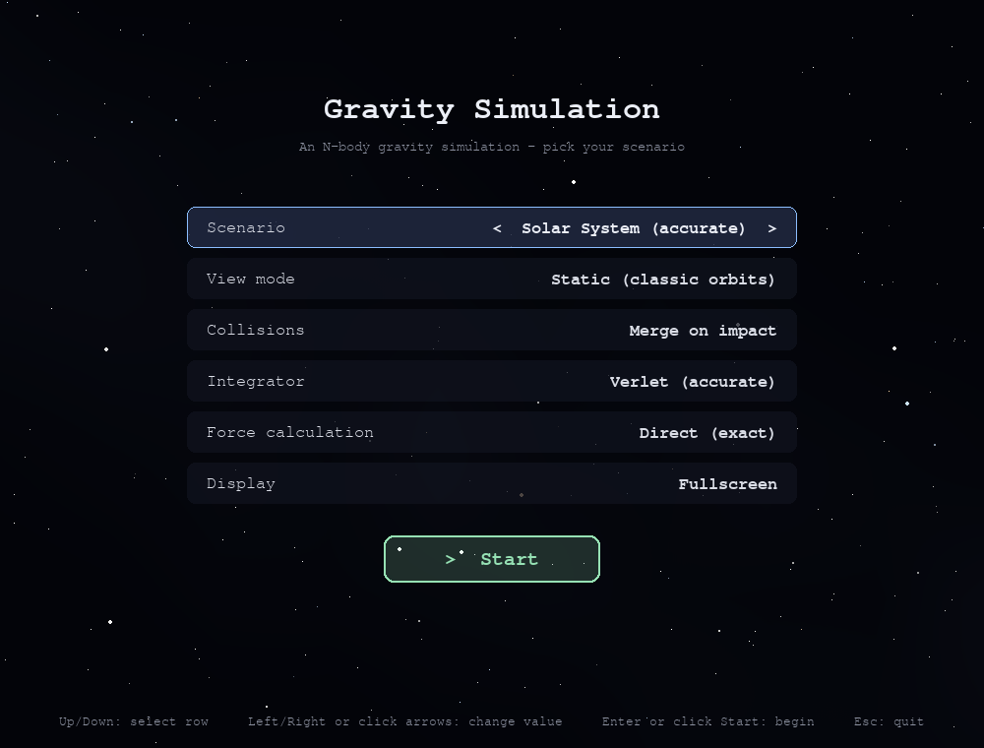
DEMONSTRATION — 1 OF 6
The Menu
No command-line flags required.
MainMenu.run() renders every option live and returns a plain settings dict when you hit Start — that dict is what main.py hands straight to the scenario builders and Simulation.
Scenario
Solar, cluster, three-body, or gravity assist
View mode
Static (classic orbits) or spiral (drifting)
Collisions
Merge on impact, or fully elastic bounce
Integrator
Verlet, Euler, or RK4
Force calculation
Direct O(n²), or Barnes-Hut approximation
16

Slide 18
DEMONSTRATION — 2 OF 6
The Spacetime Grid
Two camera modes over the same physics: a flat top-down view, and a tilted view that reveals the grid.
Bird’s-Eye (B)
Tilted Grid (T)
Flat, top-down — classic orbit-diagram framing. Easiest view for comparing distances at a glance.
Camera.TILT mode. spacetime_grid.py dips the mesh under every mass — heavier bodies dig a deeper well.
17

Slide 19
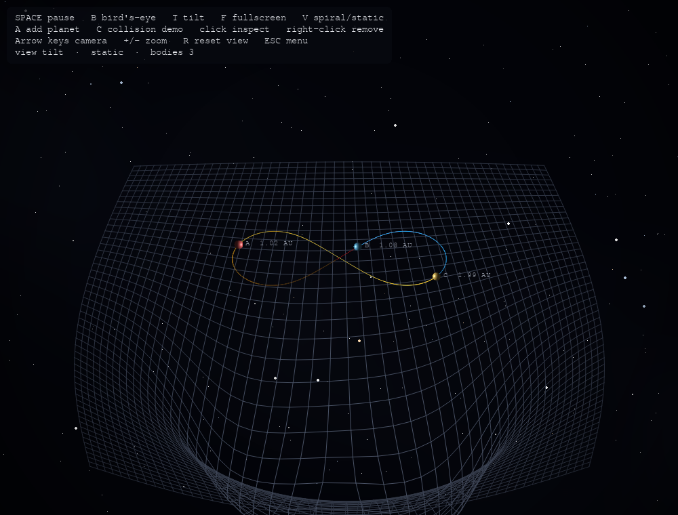
DEMONSTRATION — 3 OF 6
Scenario — Three-Body Figure-Eight
A choreographed dance
Three equal masses chase each other around one shared figure-eight path — Moore's 1993 solution to the three-body problem.
Why it's here
It's proof our integrator is accurate: this orbit only stays closed if the physics and the numerical method are both correct.
Built the same way
Constructed with build_three_body() in main.py — no special-case code, just three CelestialBody instances and the same Simulation loop.
18

Slide 20
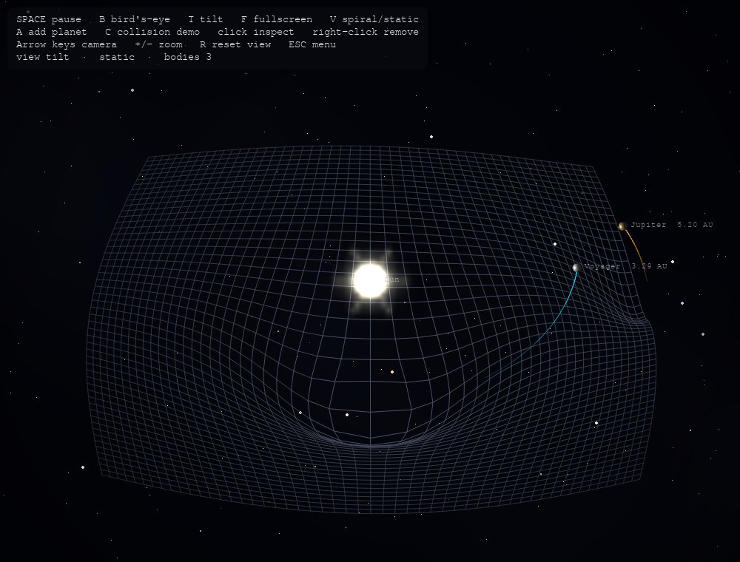
DEMONSTRATION — 4 OF 6
Scenario — Gravity Assist
The Voyager trick
A small probe swings behind Jupiter and steals a little of the planet's momentum, leaving the encounter faster than it arrived.
Free speed, real physics
No scripted boost is involved — the acceleration comes entirely from Newtonian gravity, integrated step by step like everything else.
Try it yourself
Pick “Gravity Assist” from the in-app menu and watch the probe's trail bend and stretch as it passes close to Jupiter.
19

Slide 21
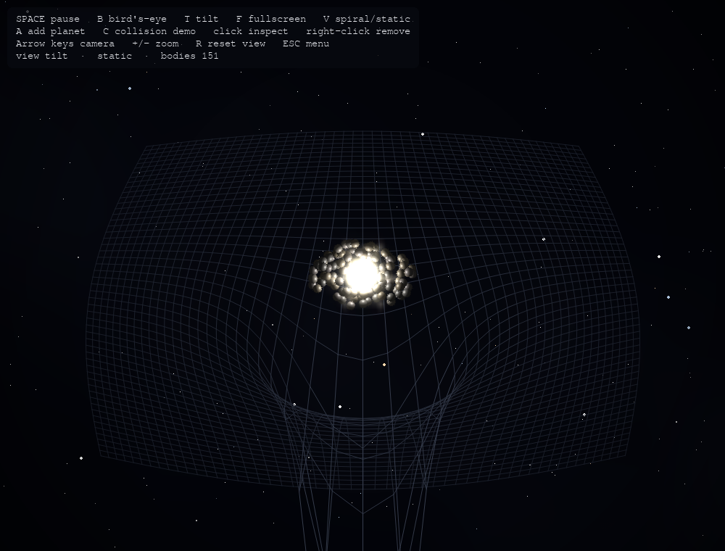
DEMONSTRATION — 5 OF 6
Scenario — Random Cluster
The stress test
150+ randomly placed bodies mutually attracting — the scenario built specifically to exercise the Barnes-Hut octree.
Direct vs. approximate
Below ~450 bodies the menu's “Direct (exact)” force calculation is used; past that, Barnes-Hut keeps frame rate stable.
What to watch
Bodies drift inward and clump under mutual gravity — a small-scale, fast-forward preview of gravitational collapse.
20

Slide 22
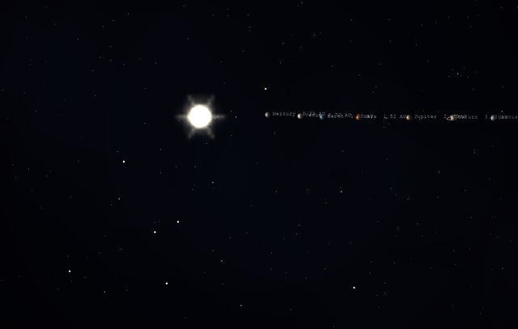
DEMONSTRATION — 6 OF 6
Scenario — Spiral / Drift Mode
The showcase view — matches the reference look this deck is styled after.
▶ LIVE MOTION — ANIMATED
Every orbit becomes a helix
In spiral mode the whole system shares one drift velocity, so each planet's flat ellipse turns into a true 3D corkscrew through space — exactly like the reference image this deck follows.
Captured straight from the sim
This is a real, high-frame-rate recording of our own Visualizer — not a mockup — toggled with the V key or the menu's “View mode” setting.
Why it matters
It's a vivid, intuitive way to see that a “stationary” solar system is really just one reference frame among many — add a drift velocity and every orbit reveals its hidden third dimension.
21

Slide 23
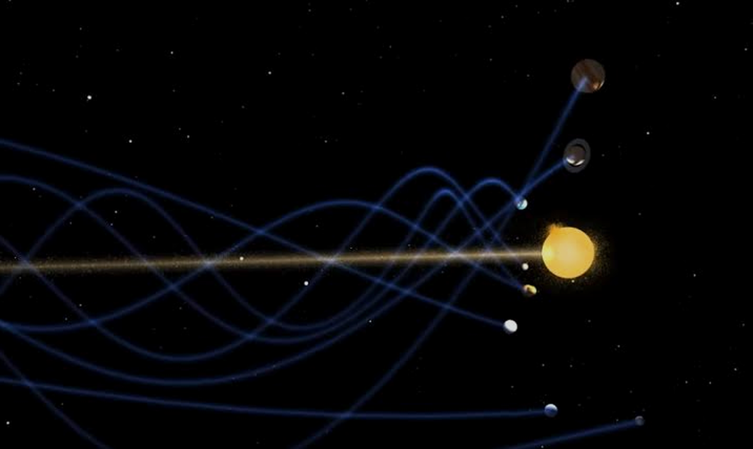

CONCLUSION
What This Project Proved
All four OOP pillars, plus composition, Strategy, and Factory, do real load-bearing work here — not a syntax demo.
Splitting rendering into composed collaborators (effects, interaction, overlay) kept a 2,200-line project easy to extend.
Three integrators and four scenarios, all built on the same Simulation core — proof the abstractions actually held up.
Thank You
Questions & Discussion Welcome

